Slide 1
Chapter- 3 Image Enhancement
Ashis Pradhan
CSE DEPARTMENT, SMIT

Slide 2
Agenda
Necessity of Image Enhancement
Spatial Domain Operations
Point processing
Histogram based techniques
Mask Processing
Frequency Domain Operations

Slide 3
Image Enhancement
Processing of an Image to enhance certain features of an Image
so that, the resultant image is more suitable than the original image for certain specific applications.
Processing techniques are very much problem oriented
Best technique for enhancement of X-ray image may not be the best for enhancement of microscopic images.

Slide 4
Different Enhancement Techniques
Enhancement technique fall under TWO broad categories:
Spatial Domain Technique
It refers to the image plane itself
approaches in this category are based on direct manipulation of pixels in an image.
Frequency Domain Technique
Approaches in this category are based on modifying the Fourier Transform of an image.
Take inverse Fourier Transform of modified coefficient to obtain enhanced image.
Note: When an image is processed for visual interpretation, the viewer is the ultimate judge of how well a particular method works.

Slide 5
Background
Spatial Domain refers to the aggregate pixels composing an image.
Spatial Domain methods are procedures that operate directly on these pixels
Spatial Domain processes will be denoted by the expression
g (x, y) = T[ f (x, y) ]
where f (x, y) is the input image, g (x, y) is the processed image, and T is an operator on f, defined over some neighborhood of (x, y). T can also operate on set of input images.

Slide 6
Point Processing
The simplest from of T is when the neighborhood is of size 1 x 1.
In this case, g depends only on the value of f at (x, y), and T becomes a gray –level transformation function of the form
s = T(r)
where r and s are the variables denoting the gray level of f (x, y) and g (x, y).
Enhancement at any point in an image depends only on gray level at that point, techniques in this category are often referred to as point processing

Slide 7
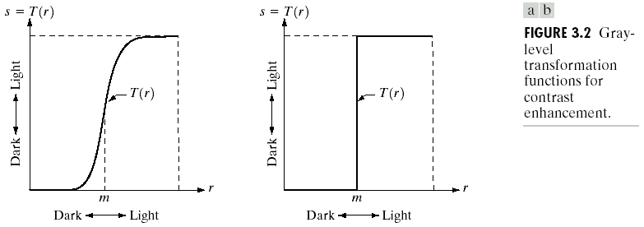
Point Processing (Example)
If T(r) has the form shown in fig (a), the effect of this transformation would be to produce an image of higher contrast than original by darkening the levels below m and brightening the level above m in the original. (Contrast Stretching)
If T(r) has the form shown in fig (b), it produces binary image (thresholding)

Slide 8
Neighborhood
Y
Origin
(x, y)
3x3 Neighborhood
Image f (x, y)
X

Slide 9
3 x 3 neighborhood about a point (x, y) in an image
The principal approach in defining a neighborhood about a point (x, y) is to use square or rectangular sub-image area centered at (x, y).
The center of the sub-image is moved from pixel to pixel starting at top left corner.
The operator T is applied at each location (x, y) to yield the output g, at that location.
The process utilizes only the pixels in the area of the images spanned by the neighborhood
Origin
y
(x, y)
Image f (x,y)
x

Slide 10
Mask processing or Filtering
A mask is a small 2D array, in which values of the mask coefficients determine the nature of the process such as image sharpening, smoothening, etc.
These mask are run through out the image on pixel by pixel basis, to change intensity value of the center pixel in the input image.
Mask are also referred as filters, kernels, templates, or windows
Example:
1/9 | 1/9 | 1/9
1/9 | 1/9 | 1/9
1/9 | 1/9 | 1/9
-1 | -1 | -1
-1 | 9 | -1
-1 | -1 | -1
Composite Laplacian Mask (Sharpen)
Arithmetic Mean Mask (Smoothen)

Slide 11
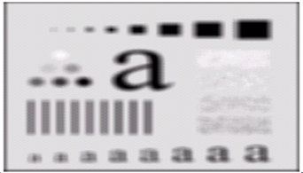
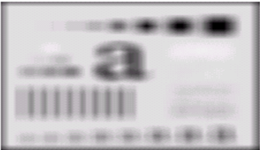

RESULT OF SMOOTHENING
RESULT OF SHARPENING

Slide 12
Mask processing
Y
W_{-1,-1} | W_{-1,0} | W_{-1,1}
W_{0,-1} | W_{0,0} | W_{0,1}
W_{+1,-1} | W_{+1,0} | W_{+1,1}
(x, y)
3x3 Mask
Image f (x, y)
X

Slide 13
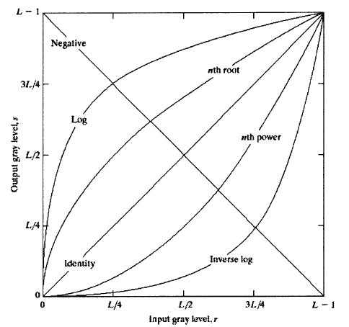
Some Basic Gray Level Transformation
Three basic type of functions frequently used for Image enhancement:
Linear
( Negative & Identity transformations)
Logarithmic
( log & Inverse-log transformation)
Power Law
(n^{th} power & n^{th} root transformations)

Slide 14
Image Negative
S=T(r)
L-1
S = T(r) = L-1-r
r
0
L-1

Slide 15
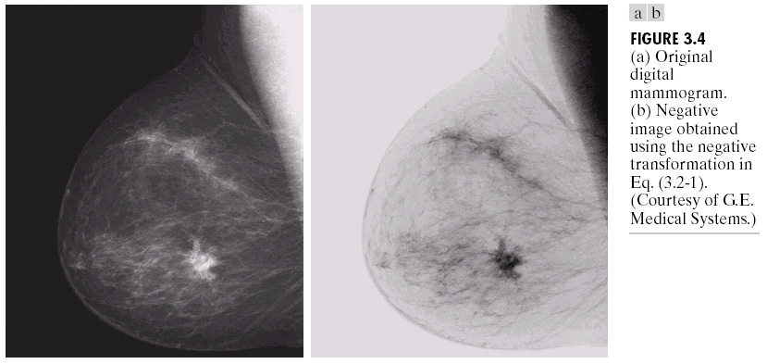
Image Negative
The negative of an image with gray levels in the range [0, L-1 ] is obtained by using the negative transformation , which is given by the expression
s = L - 1 - r
Reversing the intensity levels of an image produces the equivalent photographic negative.
This type of processing is suited for enhancing white or gray details embedded in dark region of an image (i.e. when black areas are dominant in size)

Slide 16
Log Transformation (Dynamic Range Compression)
The general form of log transformation is given by the expression
s = c log(1 + r )
where c is the constant, and r ≥ 0
This transformation maps a narrow range of low gray–level values in the input image into wider range of output levels with opposite being true for higher values of input levels.
This transformation is used to expand the values of dark pixels in an image while compressing the higher level values.
The opposite is true for the inverse log transformation.

Slide 17
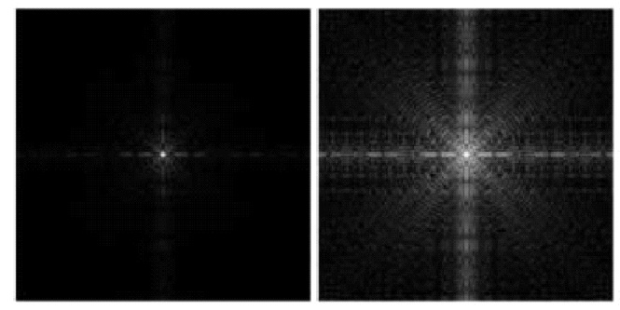
Log Transformation (Dynamic Range Compression)
Fig(a) shows Fourier spectrum with values in the range 0 to 1.5x10⁶. Apply the log transformation expression with c=1, then range of values of the result will become 0 t0 6.2.
Fig(b) shows the result of scaling this new range linearly.
FIGURE 3.5 (a) Fourier spectrum. (b) result of applying the log transformation with c=1
a
b

Slide 18
Power – Law Transformation
Power – law transformations have basic form
x = cr^{γ}
where c and γare positive constants.
Sometimes the above equation is rewritten as
x = c(r + ε)^{γ}
to account for an offset (that is, a measurable output when the input is zero).
As in the case of log transformation, Power – law curves maps a narrow range of low gray–level values in the input image into wider range of output levels with opposite being true for higher values of input levels.

Slide 19
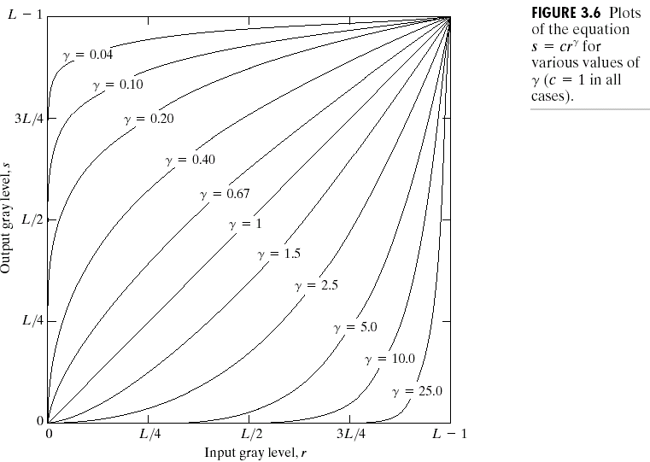
Power – Law Transformation
Family of possible transformation curves can be obtained simply by varying γ.
The curve generated with values of γ> 1 have exactly opposite effect those generated with γ< 1.
When γ=1, it reduces to identity transformation.
Power – law transformation is useful for
Gamma Correction
Contrast manipulation.

Slide 20
Gamma Correction
Most of the device used for image capture, printers, and display respond according to power law.
The process used to correct this power- law response phenomena is called Gamma Correction.
Cathode ray tube (CRT) devices have an intensity to voltage response that follows a power function with 1.8<γ<2.5.
For γ= 2.5, the Power function curve shows that the image would be darker than intended.
we preprocess the input image before inputting it to the monitor by making the gamma-correction of the image by s = γ^{1 / 2.5.}

Slide 21
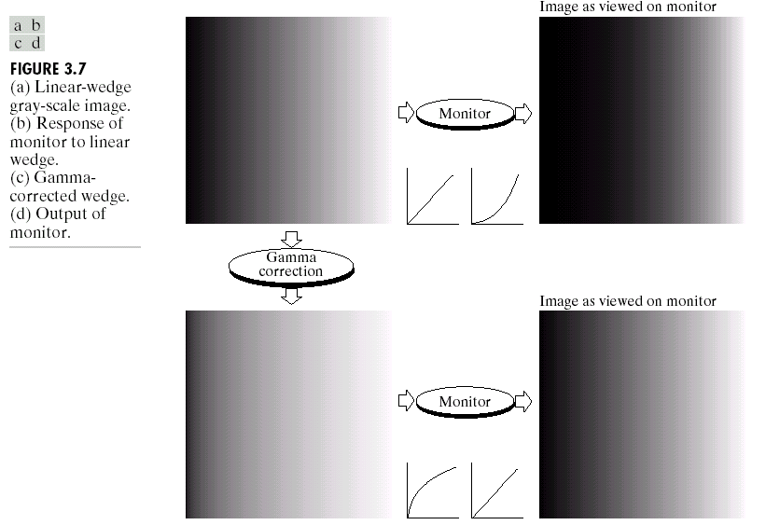

Slide 22
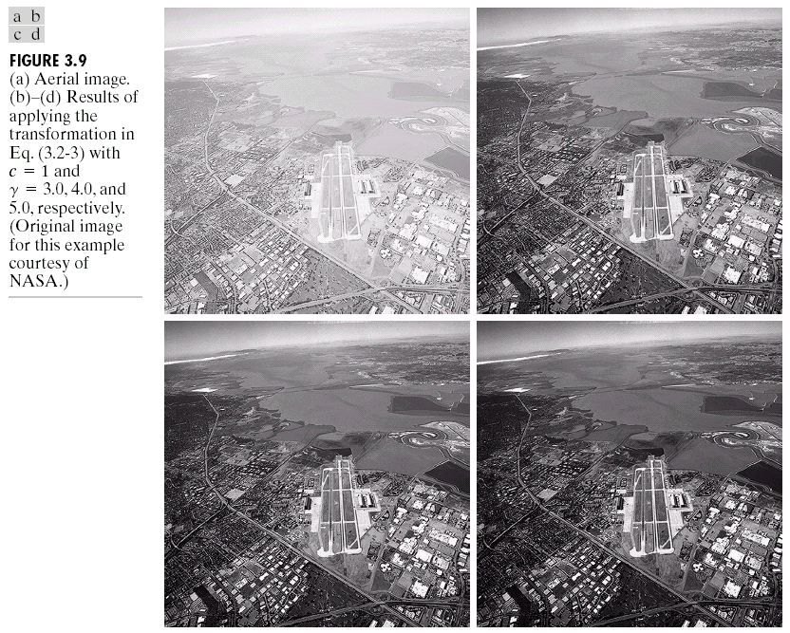
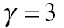
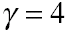
Contrast Manipulation

Slide 23
Piecewise – Linear Transformation functions
Contrast stretching:
Low –contrast images can result from poor illumination, lack of dynamic range in image sensor, or even wrong setting of a lens aperture during image acquisition.
Contrast stretching is used to increase the dynamic range of gray levels in the images being processed.

Slide 24

Contrast stretching

Slide 25
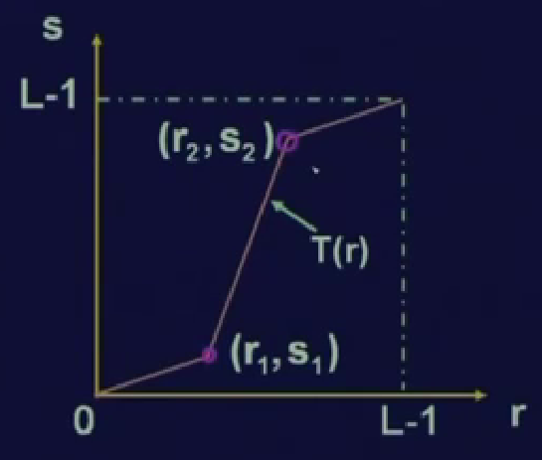
Contrast stretching

Slide 26
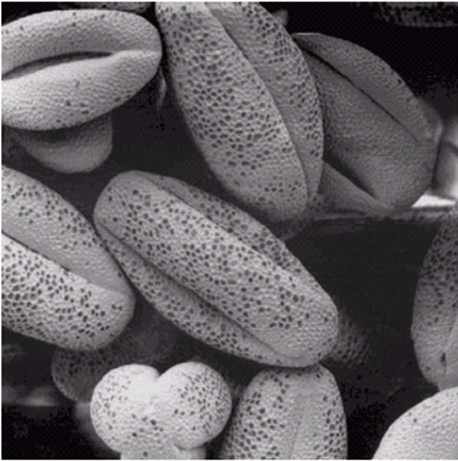
Contrast stretching

Slide 27
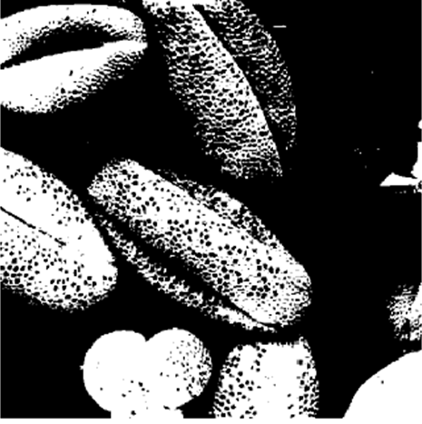
Contrast stretching

Slide 28
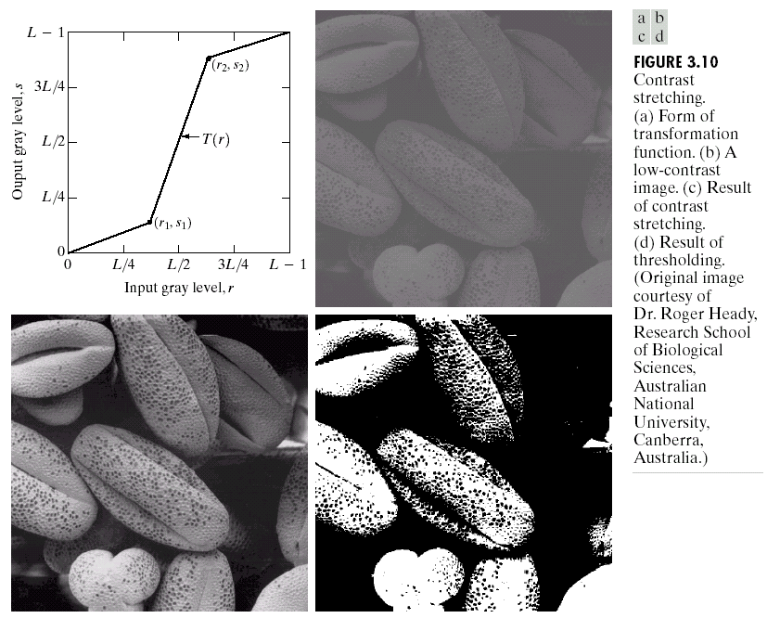

Slide 29
Contrast stretching
The location of points (r₁, s₁) and (r₂, s₂) controls the shape of the transformation function
If r₁ = s₁ and r₂ = s₂ , the transformation in linear function produces no change in gray levels.
If r₁ = r₂ , s₁=0 and s₂ = L-1 , the transformation becomes thresholding function that creates a binary image.
Intermediate values of (r₁, s₁) and (r₂, s₂) produces degree of spread in the gray levels of the output image.
In general, r₁ ≤ r₂ and s₁ ≤ s₂ is assumed so that function is single values and monotonically increasing. This prevents creation of intensity artifacts in the processed image.

Slide 30
Gray – Level Slicing
It refers to highlighting specific range of gray level in an image. For eg enhancing features such as masses of water in satellite imagery.
Two basic approaches are used
To display a high value for all gray levels in the range of interest and low value for the other gray levels. This produces the binary images.
To brightens the desired range of gray levels but preserves the back ground and gray level tonalities in the image.

Slide 31
Gray – Level Slicing
S=T(r)
L-1
L-1
S
s
r
0
A
B
L-1
0
A
B
L-1
r
r

Slide 32
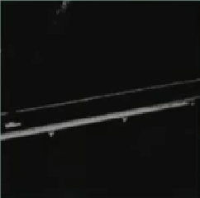
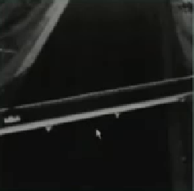
S=T(r)
L-1
L-1
S
s
r
0
A
B
L-1
0
A
B
L-1
r
r

Slide 33
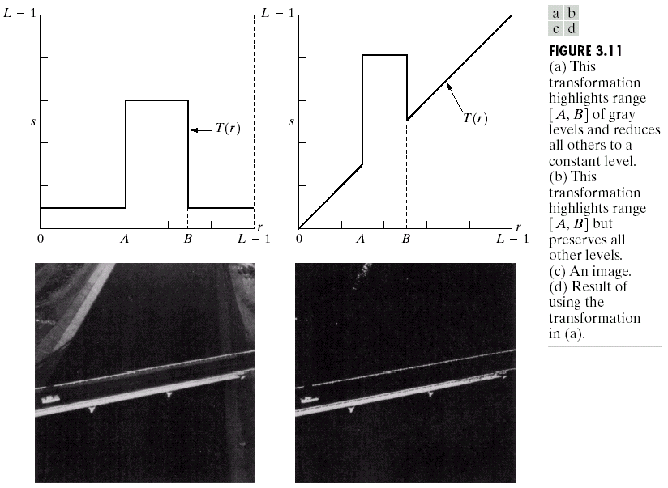

Slide 34
Bit Plane Slicing
It refers to highlighting the contribution made to total image appearance by specific bits.
Suppose that each pixel in an image is represented by 8 bits.
Image then may be thought as an image composed of eight 1-bit planes, ranging from bit plane 0 for least significant bit to bit plane 7 for most significant bit.
Higher order bits (top four) contains majority of visually significant data.
Bit plane slicing is useful for
Analyzing the relative importance played by each bit of an image.
For image compression.

Slide 35
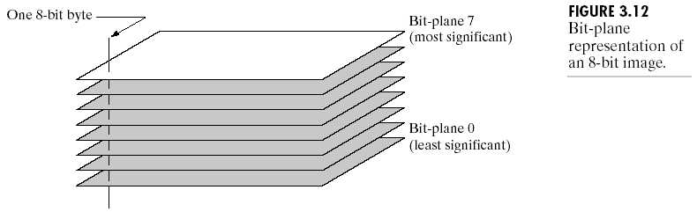
Bit Plane Slicing (contd..)
Binary image for bit plane 7 can be obtained by processing the input image with thresholding gray level transformation function that
Maps all levels in the image between 0 – 127 at one levels (for example 0), and
Maps all levels between 129 and 255 to another (for example, 255)

Slide 36
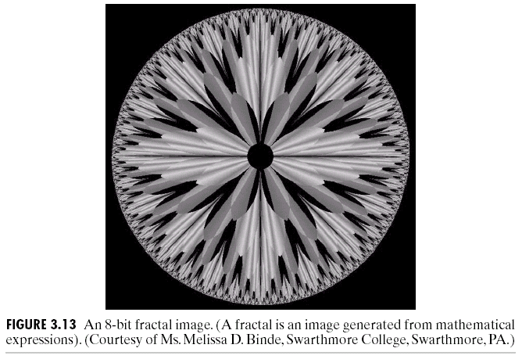
Bit Plane Slicing (contd..)

Slide 37
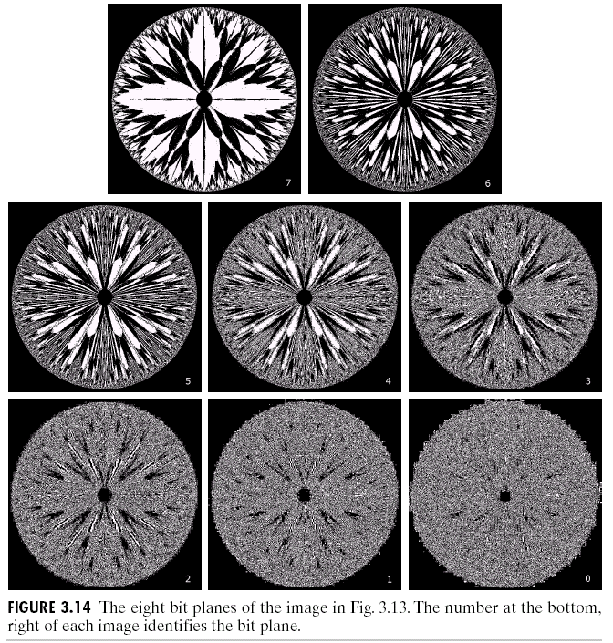
Bit Plane Slicing (contd..)

Slide 38
THANK YOU….. Any Questions ???

Slide 39
Histogram Processing
The histogram of a digital image with gray levels from 0 to L-1 is a discrete function
h(r_{k})=n_{k},
where,
r_{k} is the kth gray level,
n_{k} is the number of pixels in the image having gray level r_{k}.
Normalized histogram
p(r_{k})=n_{k}/n
where,
n is the total number of pixels in the image and
k = 0, 1, 2, …, L-1
Note: sum of all components of normalized histogram is equal to 1

Slide 40
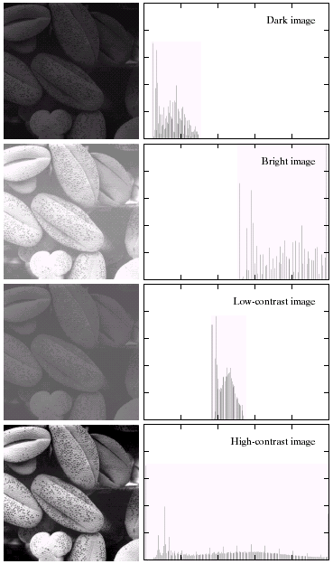
Figure shows the pollen image with four basic gray level characteristics: dark, Light, Low contrast and High contrast.
The right side of the figure shows the histogram corresponding to the images.
The histogram plots are plots of h(r_{k}) versus r_{k} or p(r_{k}) versus r_{k}.
An image whose pixels tend occupy the entire range of possible gray levels and in addition tend to be distributed uniformly, will have an high contrast and will exhibit large variety of gray tones.

Slide 41

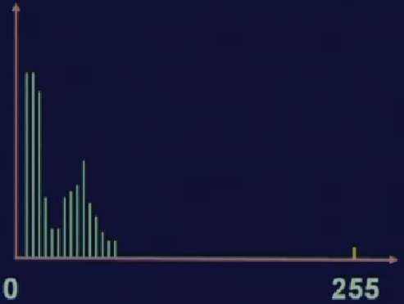
Dark Image

Slide 42
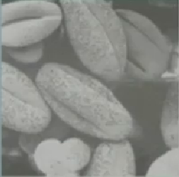
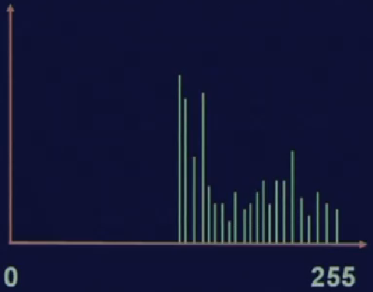
Bright Image

Slide 43

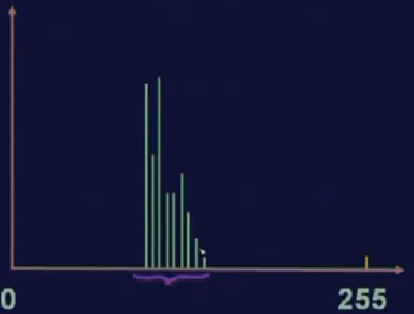
Low Contrast Image

Slide 44
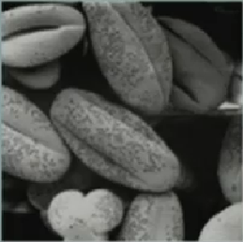
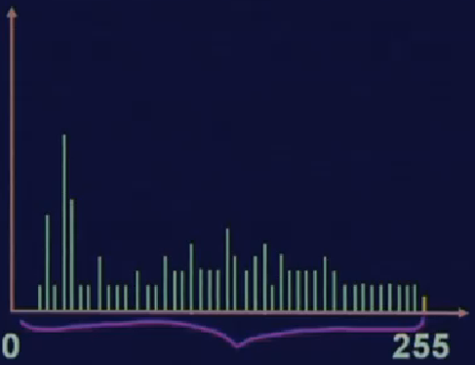
High Contrast Image

Slide 45
Histogram Processing
Types of processing:
Histogram equalization
Histogram matching (specification)
Local enhancement

Slide 46
Histogram Equalization
Histogram equalization (HE) results are similar to contrast stretching but offer the advantage of full automation, since HE automatically determines a transformation function to produce a new image with a uniform histogram.
Let r represents the gray level of the image to be enhanced, assume that r has been normalized to the interval [0,1], where r=0 representing black and r=1 representing white.
Consider the transformation of the form
s = T(r) 0 ≤ r ≤ 1
that produce a level s for every pixel value r in the original image.

Slide 47
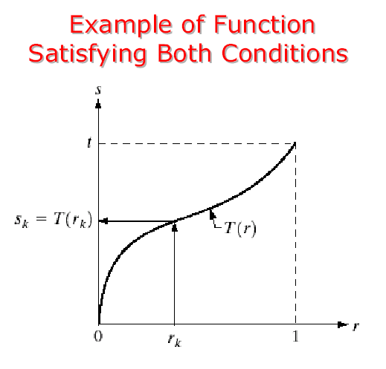
Histogram Equalization (contd..)
The transformation function t(r) satisfies the following conditions:
a) T(r) is single valued and monotonically increasing in the interval 0 ≤ r ≤ 1; and
b) 0 ≤ T(r) ≤ 1 for 0 ≤ r ≤ 1
The inverse transformation from s back to r denoted as
R = T⁻¹ (s) 0 ≤ s ≤ 1

Slide 48
Histogram Equalization:
The pixel values of an image are reassigned to a certain number of bins, which are simply numbered sets of pixels.
The pixels are then given new values, based upon the bins to which they are assigned.
The following parameters are entered:
• N - the number of bins to which pixel values can be assigned.
• M - the maximum of range of the output values. The range of the output values is from 0 to M.
The number of pixels per bin is the ratio of total number of pixels and the number of bins as shown in the following equation:
A= T/N
Where:
N = the number of bins
T = the total number of pixels in the image
A = the equalized number of pixels per bin
The pixels of each input value are assigned to bins, so that the number of pixels in each bin is as close to A as possible.

Slide 49
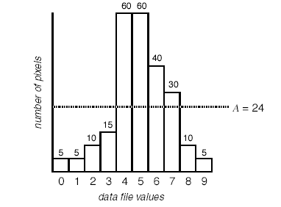
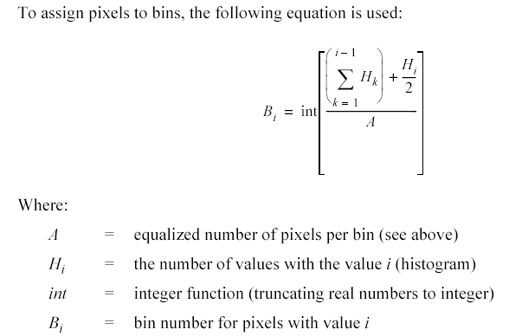
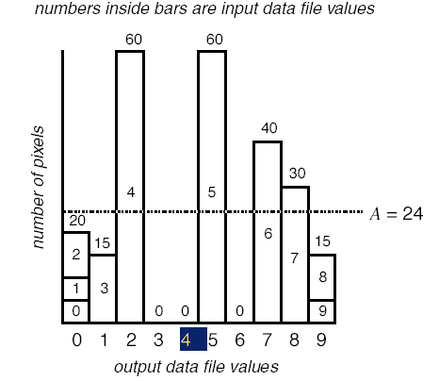
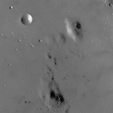
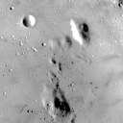

Slide 50
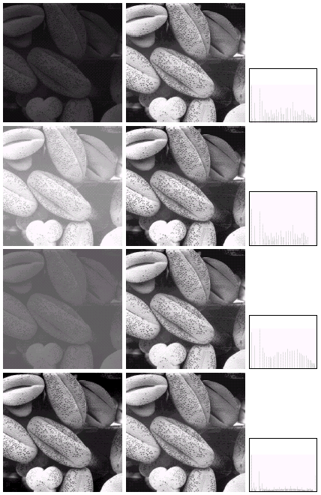

Slide 51
Histogram Equalization (Problem)
0 | 0 | 0 | 4
1 | 1 | 1 | 5
1 | 2 | 2 | 7
2 | 2 | 2 | 7
6
5
4
3
2
1
0
0 | 1 | 2 | 3 | 4 | 5 | 6 | 7
Level (r) | 0 | 1 | 2 | 3 | 4 | 5 | 6 | 7
n_{k} | 3 | 4 | 5 | 0 | 1 | 1 | 0 | 2

Slide 52
Level (r) | n _{k} | P(r _{k} )= n _{k} /n | CDF | S=CDF*(L-1) | s
0 | 3 | 0.1875 | 0.1875 | 1.3125 | = 1
1 | 4 | 0.25 | 0.4375 | 3.0625 | = 3
2 | 5 | 0.3125 | 0.75 | 5.25 | = 5
3 | 0 | 0 | 0.75 | 5.25 | = 5
4 | 1 | 0.0625 | 0.8125 | 5.6875 | = 6
5 | 1 | 0.0625 | 0.875 | 6.125 | = 6
6 | 0 | 0 | 0.875 | 6.125 | = 6
7 | 2 | 0.125 | 1 | 7 | = 7

Slide 53
Histogram Equalization (Problem)
6
5
4
3
2
1
0
0 | 0 | 0 | 4
1 | 1 | 1 | 5
1 | 2 | 2 | 7
2 | 2 | 2 | 7
0 | 1 | 2 | 3 | 4 | 5 | 6 | 7
1 | 1 | 1 | 6
3 | 3 | 3 | 6
3 | 5 | 5 | 7
5 | 5 | 5 | 7
6
5
4
3
2
1
0
0 | 1 | 2 | 3 | 4 | 5 | 6 | 7

Slide 54
THANK YOU….. Any Questions ???

Slide 55
Histogram Matching (or Specification)
It is the method used to generate a processed image that has a specified histogram.
Let p_{r}(r ) and p_{z}(z) denote their corresponding continuous probability density functions. Where r and z denotes the gray levels of the input and output images.
We estimate p_{r} (r) from the given input image. While p_{z}(z) is the specified probability density function that we wish the output image to have.

Slide 56
Histogram Matching (or Specification)
Let s be the random variable with property
……. 1
Suppose we define a random variable z with the property
…….. 2
From the above two equation G(z) = T(r) and therefore z must satisfy the condition

Slide 57
Histogram Matching (or Specification)
Procedure to obtain specified probability density function:
Obtain the transformation function T(r) using equation 1.
Use equation 2 to obtain the transformation function G(z).
Obtain the inverse transformation function G⁻¹.
Obtain the output image by applying equation 3 to all pixels in the input image.
The result of this procedure will be an image whose gray levels z, have the specified probability density function p_{z}(z).

Slide 58
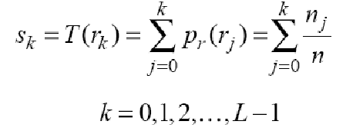
Histogram Matching (or Specification)
How to compute G ⁻¹?
The discrete formulation of equation 1 is given by
v_{k} = G(z _{k})= …….4

Slide 59
Histogram Matching (or Specification)
Procedure for histogram matching:
Obtain the histogram of the given image.
Use equation 4 to pre-compute a mapped level s_{k} for each level r_{k}
Obtain the transformation function G from the given p_{z} (z).
Pre-compute z_{k} for each value of s_{k}
Starting s_{k} =0, iterate to find smallest z_{k} which approximately satisfies
(G(z_{k}) – s_{k})=0; repeat for all s_{k} up to 1
For each pixel in the original image, if the value of that pixel is r_{k}, map this value to its corresponding level s_{k;} then map level s_{k} into the final level Z_{k}

Slide 60
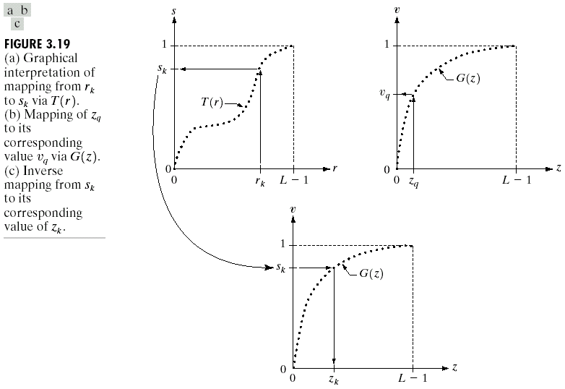

Slide 61
Histogram Matching (Example)
0 | 0 | 0 | 4
1 | 1 | 1 | 5
1 | 2 | 2 | 7
2 | 2 | 2 | 7
Input Image frequency distribution Table
r _{k} | 0 | 1 | 2 | 3 | 4 | 5 | 6 | 7
Freq. | 3 | 4 | 5 | 0 | 1 | 1 | 0 | 2
Perform Histogram Matching for the following specified histogram
r _{k} | 0 | 1 | 2 | 3 | 4 | 5 | 6 | 7
Freq. | 2 | 3 | 3 | 3 | 2 | 1 | 1 | 1

Slide 62
FOR GIVEN INPUT IMAGE
Level (r _{k}) | n _{k} | P(n _{k} )= n _{k} /n | CDF (n _{k})
0 | 3 | 0.1875 | 0.1875
1 | 4 | 0.25 | 0.4375
2 | 5 | 0.3125 | 0.75
3 | 0 | 0 | 0.75
4 | 1 | 0.0625 | 0.8125
5 | 1 | 0.0625 | 0.875
6 | 0 | 0 | 0.875
7 | 2 | 0.125 | 1

Slide 63
FOR SPECIFIED HISTOGRAM
Level (r _{k}) | z _{k} | P(z _{k} )= z _{k} /n | CDF (z _{k})
0 | 2 | 0.125 | 0.125
1 | 3 | 0.1875 | 0.3125
2 | 3 | 0.1875 | 0.5
3 | 3 | 0.1875 | 0.6875
4 | 2 | 0.125 | 0.8125
5 | 1 | 0.0625 | 0.875
6 | 1 | 0.0625 | 0.9375
7 | 1 | 0.0625 | 1

Slide 64
HISTOGRAM MATCHING
Level (r _{k}) | CDF (n _{k}) | CDF (z _{k}) | Best Matched level (r _{k})
0 | 0.1875 | 0.125 | 0
1 | 0.4375 | 0.3125 | 2
2 | 0.75 | 0.5 | 3
3 | 0.75 | 0.6875 | 3
4 | 0.8125 | 0.8125 | 4
5 | 0.875 | 0.875 | 5
6 | 0.875 | 0.9375 | 5
7 | 1 | 1 | 7

Slide 65
Noise Models
What is noise?
Noise is the unwanted signal that arises during image acquisition and/or transmission.
The performance of imaging sensors is affected by variety of factors such as environmental conditions during image acquisition and by the quality of the sensing elements themselves.

Slide 66
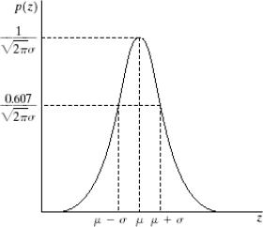
Noise Models
Gaussian Noise :
The PDF of a Gaussian random variable, z, is given by
where z represents gray level, μ is the mean value of z and σ is the standard deviation.

Slide 67
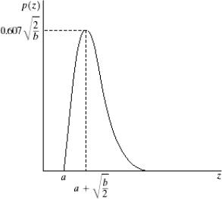
Noise Models
Rayleigh Noise :
The PDF of a Rayleigh noise, z, is given by
for z ≥ a
for z < a
where and

Slide 68
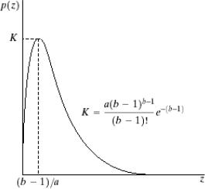
Noise Models
Erlang (Gamma) Noise :
The PDF of a Gamma noise, z, is given by
for z ≥ a
for z < a
where and

Slide 69
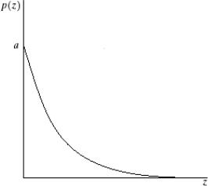
Noise Models
Exponential Noise :
The PDF of a Exponential noise, z, is given by
for z ≥ a
for z < a
where and

Slide 70
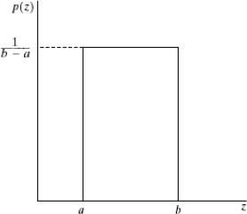
Noise Models
Uniform Noise :
The PDF of a Uniform noise, z, is given by
for a ≤ z ≤ b
otherwise
where and

Slide 71
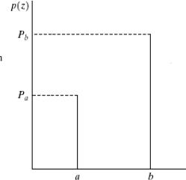
Noise Models
Impulse (salt-and-pepper noise Noise :
The PDF of a bipolar impulse noise, z, is given by
for z=a
for z=b
otherwise

Slide 72

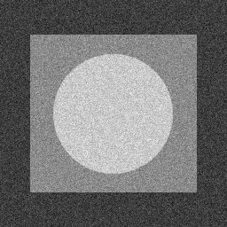
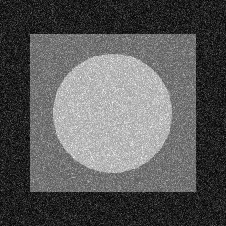
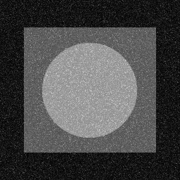
Noise Models
a) Original Image b) Gaussian Noise
c) Rayleigh Noise d) Gamma Noise

Slide 73
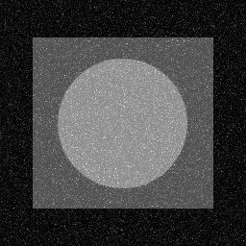
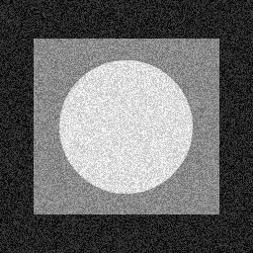
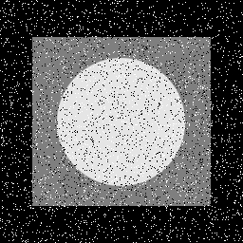
Noise Models
a) Original Image b) Exponential Noise
c)Uniform Noise d)Salt-and-pepper Noise

Slide 74
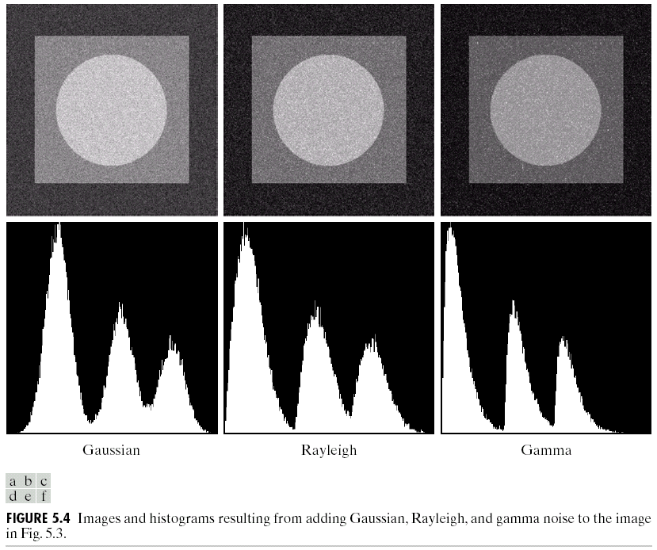

Slide 75


Slide 76
IMAGE ENHANCEMENT USING SPATIAL FILTERING (Basic Concept)

Slide 77
Spatial filtering
Unlike point processing, the larger neighborhoods allow considerably more flexibility. The general approach is to use a function of the values of f in a predefined neighborhood of (x, y) to determine the value of g at (x,y).
Such formulation is based on the use of masks/ filters/ kernels/ templates/ windows. The values in the mask is referred to as co-efficient instead of pixels.
Basically a mask is small ( say 3 x 3 ) 2D array, as shown below, in which, the values of the mask coefficients determine the nature of the process, such as Image sharpening and is known as mask processing or filtering

Slide 78
Mask processing
Y
W_{-1,-1} | W_{-1,0} | W_{-1,1}
W_{0,-1} | W_{0,0} | W_{0,1}
W_{+1,-1} | W_{+1,0} | W_{+1,1}
(x, y)
3x3 Mask
Image f (x, y)
X

Slide 79
Mask processing
W_{-1,-1} | W_{-1,0} | W_{-1,1}
W_{0,-1} | W_{0,0} | W_{0,1}
W_{+1,-1} | W_{+1,0} | W_{+1,1}
Y
(x, y)
3x3 Mask
F(x-1,y-1) | F(x-1,y) | F(x-1,y+1)
F(x,y-1) | F(x,y) | F(x,y+1)
F(x+1,y-1) | F(x+1,y) | F(x+1,y+1)
X
Image f (x, y)

Slide 80

Basics of spatial filtering

Slide 81
Basics of spatial filtering (contd..)
The process consists of moving the filter mask from point to point in an image.
At each point (x, y), the response of the filter at that point is calculated using a predefined relationship.
For linear spatial filtering, the response is given by a sum of products of the filter coefficients and the corresponding images pixels in the area spanned by the filter mask.
i.e. response, R of linear filtering with the filter mask at a point (x, y) in the image is
R = w(-1,-1)f(x-1,y-1) + w(-1,0)f(x-1,y) +…+ w(1,1)f(x+1,y+1)

Slide 82
Basics of spatial filtering(contd..)
In general, linear filtering of an image f of size M x N with a filter mask of size m x n is given by the expression:
…….. (3.5-1)
where a=(m-1)/2 and b=(n-1)/2.
To generate a complete filtered image this equation must be applied for:
x= 0,1, ….., M-1 and
y= 0,1,….,N-1

Slide 83

Basics of spatial filtering (contd..)
Process of linear filtering given in equation (3.5-1)is similar to frequency domain concept called convolution. Therefore the filter mask is also known as convolution masks.
Alternative notation:
Let the filter mask be The expression 3.5-1 will be then
simplified as
where w_{i} are the mask coefficients and z_{i} are the values of image gray levels corresponding to the mask coefficients.

Slide 84
Basics of spatial filtering (contd..)
Consider a square mask of size n x n. At least one edge of such mask will coincide with the border of the image when center of the mask is at distance of (n-1)/2 pixels away from the border
If the center of the mask moves closer to the border, then one or more rows or columns of the mask is located outside the image plane.
One way to obtain filtered image, ignore border pixels:
limit the excursion of the mask to be at distance no less that (n-1)/2 pixels from the border. (resultant filtered image will be smaller)

Slide 85
Basics of spatial filtering (contd..)
Other methods to process the border of an image plane several methods are used
Filter all the pixels only with the section of mask that is fully contained. (resultant filtered image will be of same size, but border pixels are processed with partial filters)
“padding” the image by adding rows and columns of 0’s, or padding by replicating rows or columns. The padding is then stripped off at the end of the process. (resultant filtered image will be of same size, but will have an effect near the border )

Slide 86
IMAGE ENHANCEMENT USING SPATIAL FILTERING (Smoothing Operation)

Slide 87
Smoothing Spatial Filter
Smoothing filters are used for blurring and noise reduction.
Blurring is used in preprocessing steps, to remove small details from an image prior to object extraction and to bridge small gaps in lines or curves.
Smoothening linear (Mean) filters:
The output (response) of a smoothing linear spatial filter is simply the average of the pixels contained in the neighborhood of the filter mask.
Smoothening Non-Linear (Order statistics) filters:
The output (response) is based on the ordering (ranking) the pixels contained in the image area encompassed by the filter.

Slide 88
Types of Spatial Filter
Smoothening linear (Mean) filters:
Simple Mean
Geometric Mean
Harmonic Mean
Contra-harmonic Mean
Weighted Mean
Smoothening Non-Linear (Order statistics) filters:
Median Filter
Max Filter
Min Filter
Mid Point Filter
Alpha-trimmed Filter

Slide 89
Mean Filters
Arithmetic mean:
Let S_{xy} represents the set of coordinates in rectangular sub image window of size m x n, centered at point (x, y). The pixel value of the processed image g(x, y) at any point (x, y) is simply the arithmetic mean computed using the pixels in the region define by S_{xy}.
1/9 | 1/9 | 1/9
1/9 | 1/9 | 1/9
1/9 | 1/9 | 1/9
3 x 3 convolution mask

Slide 90
Mean Filters
Geometric Mean:
Let S_{xy} represents the set of coordinates in rectangular sub image window of size m x n, centered at point (x, y). The pixel value of the processed image g(x, y) at any point (x, y) is given by the product of the pixels in the sub-image window, raised to the power 1/mn.

Slide 91


Effects of Geometric Mean filters

Slide 92
Mean Filters
Harmonic Mean:
Let S_{xy} represents the set of coordinates in rectangular sub image window of size m x n, centered at point (x, y). The pixel value of the processed image g(x, y) at any point (x, y) is given by the expression

Slide 93


Effects of Harmonic Mean filters

Slide 94
Mean Filters
Contra harmonic Mean:
Let S_{xy} represents the set of coordinates in rectangular sub image window of size m x n, centered at point (x, y). The pixel value of the processed image g(x, y) at any point (x, y) is given by the expression
where Q is called the is order of the filter. Q>0 used for removing pepper noise and Q<0 is used for reducing salt noise.

Slide 95

Effects of Contra-Harmonic Mean filters

Slide 96
Mean Filters
Weighted Mean:
Let S_{xy} represents the set of coordinates in rectangular sub image window of size m x n, centered at point (x, y). The pixel value of the processed image g(x, y) at any point (x, y) is given by the expression
1/16 x
1 | 2 | 1
2 | 4 | 2
1 | 2 | 1
3 x 3 convolution mask

Slide 97

Effects of Weighted Mean filters

Slide 98
Mean Filters (summary)
Arithmetic Mean :
It smoothes local variations in an image. (Removes Gaussian and uniform noise)
Noise is reduced as a result of blurring.
Geometric Mean:
Achieves smoothing, but it tends to lose less image detail than arithmetic mean filter.
Removes Gaussian noise.
Harmonic mean filter:
It works well for salt noise, buts fails for pepper noise.
Removes Gaussian noise.
Contra-harmonic Mean filters:
For negative value of Q, it eliminates salt noise.
For positive value of Q, it eliminates pepper noise.
Weighted Mean:
It attempts to reduce blurring in the smoothing process.

Slide 99
Order Statistics filters
Median Filter
This Filter replaces the value of a pixel by the median of the gray levels in the neighborhood of that pixel:
It works well with the image having bipolar and unipolar impulse noise.

Slide 100

Effects of Median filters

Slide 101
Order Statistics filters
Max and Min Filter
The Max filter replaces the value of a pixel by the highest gray level in the neighborhood of that pixel:
It works well with the image having pepper noise.
The Min filter replaces the value of a pixel by the lowest gray level in the neighborhood of that pixel:
It works well with the image having salt noise.

Slide 102

Effects of Max filters

Slide 103

Effects of Min filters

Slide 104
Order Statistics filters
Midpoint Filter
It simply computes the midpoint between the maximum and minimum values in the neighborhood of that pixel:
It works well with the image having randomly distributed noise like Gaussian or uniform noise.

Slide 105

Effects of Mid-point filters

Slide 106
Order Statistics filters
Alpha-trimmed mean Filter
Suppose that we delete the lowest d/2 and highest d/2 gray levels values of f(s, t) in the neighborhood S_{xy}. Let f_{r}(s, t) represent the remaining mn-d pixels. A filter formed by averaging these remaining pixels is called an alpha-trimmed mean filter:
where d can range from 0 to mn-1.
It works well with the image having combination of Gaussian and salt-and-pepper noise.

Slide 107

Effects of Alpha-trimmed filters

Slide 108

Arithmetic and Geometric Mean Filter: An example

Slide 109

Contra harmonic Mean Filter: An example

Slide 110

Contra harmonic Mean Filter: An example

Slide 111

Median Filter: An example

Slide 112

Max Filter: An example

Slide 113
Median Filter | •Works well on salt-and-pepper noise
Max Filter | •Useful for finding the brightest points in an image •Reduces pepper noise.
Min Filter | •Useful for finding the darkest points in an image •Reduces salt noise.
Mid-point filter | •Combines order statistic and averaging • Works best for randomly distributed noise, like Gaussian or uniform noise
Alpha-trimmed mean filter | •Less affected by noise compared to arithmetic mean filter •Useful for the multiple types of noise such as the combination of salt-and-pepper and Gaussian noise.

Slide 114


Spatial Filter: An example

Slide 115


Effects of Linear Filter

Slide 116

Effects of Linear Filter

Slide 117

Effects of Linear & Non Linear Filter

Slide 118
IMAGE ENHANCEMENT USING SPATIAL FILTERING (Sharpening Operation)

Slide 119
Sharpening Spatial Filters
Used to highlight fine detail in an image or to enhance detail that has been blurred.
Image blurring is accomplished in spatial domain by pixel averaging in the neighborhood.
Since averaging is analogous to integration, sharpening can be accomplished by spatial differentiation.
Image differentiation enhances edges and other discontinuities and deemphasizes areas with slowly varying gray level values.

Slide 120
Sharpening Spatial Filter (contd..)
The derivatives of digital function are defined in terms of differences.
First derivative
Must be zero in flat segments (areas of constant gray-level values)
Must be nonzero at the onset of a gray-level step or ramp.
Must be non zero along ramps
Second derivative:
Must be zero in flat areas
Must be nonzero at the onset of a gray-level step or ramp.
Must be zero along ramps

Slide 121
Sharpening Spatial Filter (contd..)
First order derivative of a one-dimensional function f(x) is the difference
And second order derivative is defined as the difference

Slide 122

Sharpening Spatial Filters

Slide 123
Sharpening Spatial Filter (contd..)
Note:
First order derivative is non zero along the entire ramp. Edges in the images resemble this kind of the transition so we conclude that first order derivatives produces “ thick” edges
Second order derivative is non-zero only at the on-set and end of the ramp, thus produces fine edges.
Summary:
First order derivatives generally produces thicker edges in an image, second order derivative have a stronger response to fine detail, such as thin lines and isolated points.
First order derivatives generally have stronger response at step changes in gray –level, but second order derivatives produces a double response at step changes in gray levels

Slide 124
Sharpening Spatial Filter (contd..)
Use of Second Order Derivative for enhancement – The Laplacian
Laplacian Operator/filter is a linear and the simplest isotropic operator used for image sharpening.
Isotropic Filter are those filters whose response is independent of the direction of discontinuities in the image to which the filter is applied.
Isotropic filters are also called rotation invariant in the sense that rotating image and then applying the filter gives the same result as applying the filter to the image and then rotating the result.
For function (image) f (x, y) of two variables, Laplacian is defines as

Slide 125
Sharpening Spatial Filter- Laplacian
To express in discrete form we consider the partial second order derivative in x direction and y-direction:

Slide 126
Sharpening Spatial Filter- Laplacian
The digital implementation of two-dimensional Laplacian is obtained by summing these two components:

Slide 127

Laplacian Filter Mask

Slide 128
Sharpening Spatial Filter- Laplacian
Laplacian is a derivative operator, its use highlights gray-level discontinuities in an image and deemphasizes regions with slowly varying gray levels.
This will tend to produce images that have grayish edge lines and other discontinuities, all superimposed on a dark, featureless background.
Back ground feature can be recovered by adding or subtracting the original image with the laplacian images.
The basic way to use Laplacian for image enhancement is follows:
if the center coefficient of the
Laplacian mask is negative
if the center coefficient of the
Laplacian mask is positive.

Slide 129

Sharpening Spatial Filter- Laplacian

Slide 130
Sharpening Spatial Filter- Laplacian
Simplified Mask:
Instead of computing the laplacian filtered image and then subtracting it from the original image, in practice it is usually implemented with one pass of single mask.
The coefficient of the single mask are easily obtained by substituting expression for Δ²f(x,y) in the expression for g (x, y)

Slide 131

Sharpening Spatial Filter- Laplacian

Slide 132
Unsharp masking and high-boost filtering
Unsharp masking is a process used to sharpen images consists of subtracting a blurred version of an image from the image itself.
where f_{s} (x, y) denotes the sharpened image obtained by unsharp masking, f ’(x,y) is the blurred version of f(x,y)
High boost filtered image f_{hb} is defined at any point (x,y) as
where A≥1.

Slide 133

Unsharp masking and high-boost filtering
Mask Used:
If we elect to use laplacian,
if the center coefficient of the
Laplacian mask is negative
if the center coefficient of the
Laplacian mask is positive.

Slide 134
Unsharp masking and high-boost filtering
Note:
If A=1, high boot filtering becomes “standard” Laplacian sharpening.
If A increase, the contribution of sharpening process becomes less and less importance.
If A is large enough, high boost image will be approximately equal to original image multiplied by the constant.

Slide 135

Unsharp masking and high-boost filtering

Slide 136
Sharpening Spatial filter (contd..)
Use of first derivative for Enhancement – The Gradient
First derivatives in image processing are implemented using the magnitude of the gradient.
For function f(x,y), the gradient of f at coordinates (x,y) is defined as the two dimensional column vector.
The magnitude of this vector is given by

Slide 137
Sharpening Spatial filter (contd..)
To reduce the computation involved, it is common practice to approximate the magnitude of gradient:
equ -1
We now define digital approximation to the above equation:
Consider a mask of size 3 x 3 centered at (x,y) denoted by z₅
Simplest approximation to first order derivative that satisfy the condition stated are G_{x}=(z₈ - z₅) and G_{y}=(z₉ – z₆)
The equation 1 can then be implemented by two mask commonly known as Roberts cross-gradient operator.
Masks of even size are difficult to implement.

Slide 138
Sharpening Spatial filter (contd..)
Sobel Operator:
An approximation using absolute values, still at point z₅, but using a 3x3 mask is
The difference between third and the first rows of the 3 x 3 images region approximates the derivative in x-direction and The difference between third and the first column of the 3 x 3 images region approximates the derivative in y-direction.

Slide 139

Chapter 3
Image Enhancement in the
Spatial Domain

Slide 140

Chapter 3
Image Enhancement in the
Spatial Domain

Slide 141


Combining Spatial Enhancement methods

Slide 142


Combining Spatial Enhancement methods

